Slide 1

Material Classification
A combination of deep features and handcrafted features.
Trương Phúc Anh
Computer Vision

Slide 2
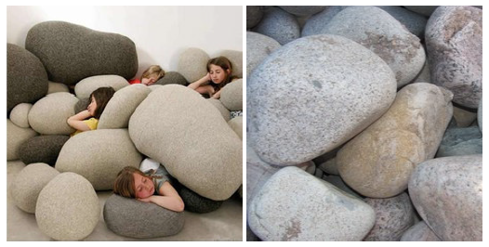
Contents
1
Introduction.
2
Related works.
3
Datasets.
4
Method
5
Results and Conclusion
Figure 1. While the main object in both scenes can be considered
as ”stone” it is obvious that their material is different
6
Questions.

Slide 3
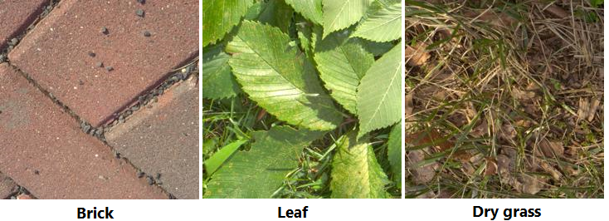
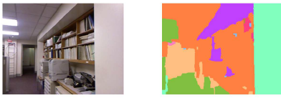
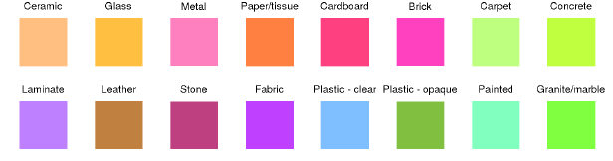
Introduction
What is material classification?
The main goal is providing the detail of material information in an image.
In simple words, given an image I, the computer need to find out what material its surface is made of (such as metal, plastic, stone, brick, glass, wood, etc.).
A higher level, the computer even need to know exactly what material class for every single pixel in the image.

Slide 4
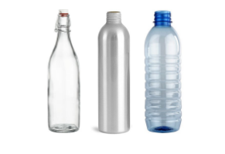
Introduction
Why do we need material classification?
Material of surfaces contribute valuable information for computer to understand and interact with the world (just like human).
It is one of significant keys for improving scene understanding in Computer Vision [1].
Being used in variety of applications in real world such as Advanced Driver-Assistance Systems [2], Robotic Manipulation [3], Robotic Navigation [4], etc.
Figure 1. Bottles with similar shape are made are made of different materials which decides its physical properties and could be extremely useful information in various situation.

Slide 5
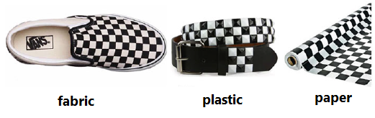
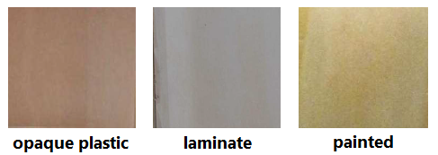
Introduction
Challenges
Surface texture, geometry variants.
Similar texture patterns, shape with different materials.
Lighting conditions.
Clutter.
Combining them.
Figure 1. Surfaces with similar texture
Figure 2. Samples from Open-Surfaces

Slide 6
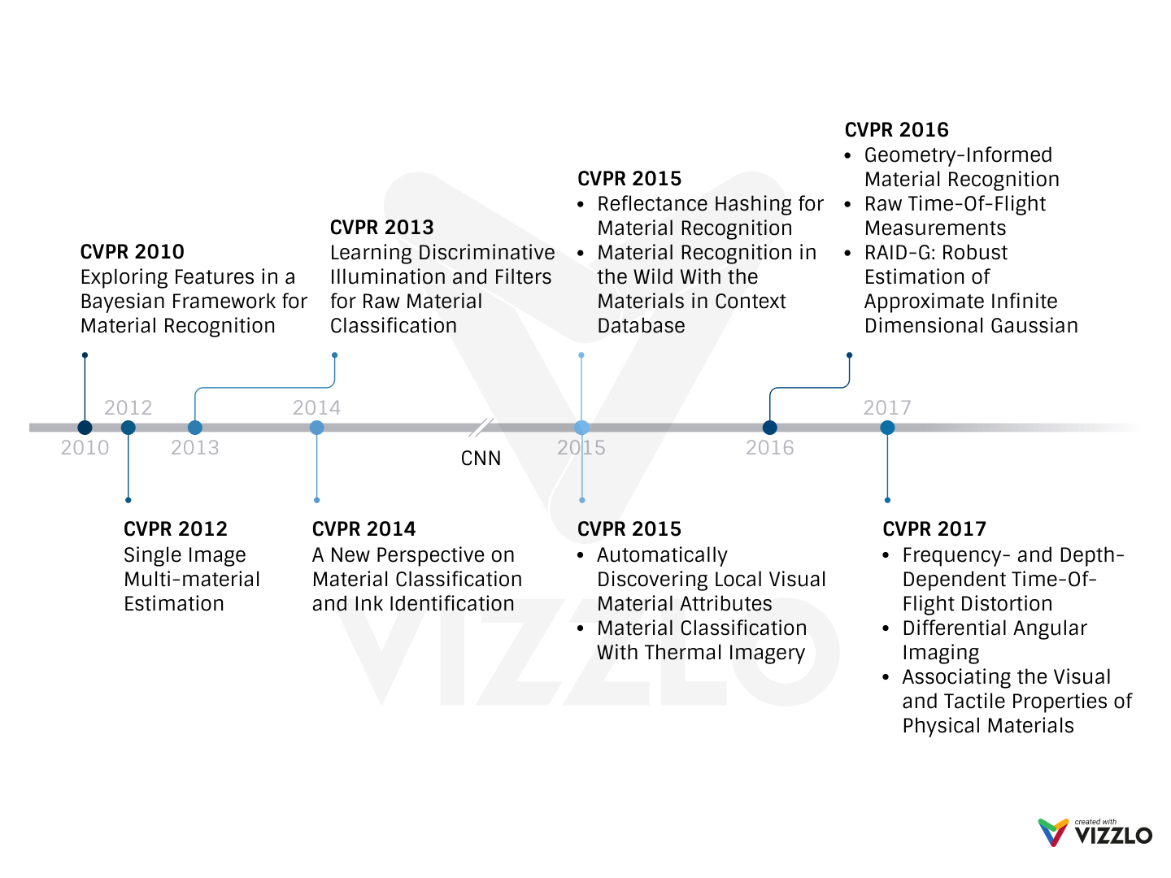
Related Works - CVPR Milestone
Notes:
After we transfer Deep Neural Networks for Computer Vision tasks, A lot of research about this task have been published with extremely accurate (almost like human)

Slide 7
Datasets
Name | Samples | Classes | Views | Illumination | In scene | Scene image | Camera parameters | Year
CUReT | 61 | 61 | 205 | 205 | No | No | No | 1999
KTH-TIPS | 11 | 11 | 27 | 3 | No | No | No | 2004
UBO2014 | 84 | 7 | 151 | 151 | No | No | No | 2014
Reflectance | 190 | 19 | 3 | 3 | No | No | Yes | 2015
4D Light-field | 1200 | 12 | 1 | 1 | Yes | No | No | 2016
NISAR | 100 | 100 | 9 | 12 | No | No | No | 2016
GTOS | 606 | 40 | 19 | 4 | Yes | Yes | Yes | 2016
Table 1. Some publicly available BRDF material datasets [5]. Note that the 4D Light-field dataset is captured by the Lytro Illum light field camera.
Notes:
One again, we see that, DNNs and CNNs affect on the datasets. It becomes more and more challenge with lager-scale (trends in CVRP)

Slide 8
Method
Proposed method
2D RGB image-based classification method.
Using deep feature from the original image, geometry and texture information as handcrafted local features.
Solved problem: surface texture, geometry variants. Previous methods using 3D image (with deep information) or physical parameters like elasticity.
Material Classification using Frequency and Depth Dependent Time-of-Flight Distortion (CVPR 2017)
Geometry-Informed Material Recognition (CVPR 2016)
Reflectance Hashing for Material Recognition (CVPR 2015)
…
Figure 1. Surfaces with similar texture and different shapes
Figure 2. Surfaces with similar shape and different textures

Slide 9
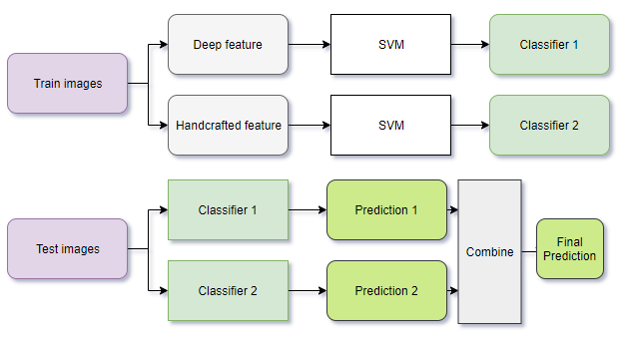
Method
Approach 1. Combine predictions from different classifiers. (Post-fusion)

Slide 10
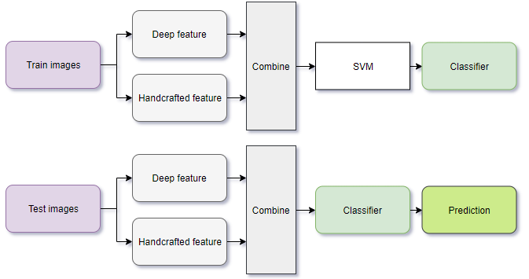
Method
Approach 2. Combine features (Pre-fusion)

Slide 11
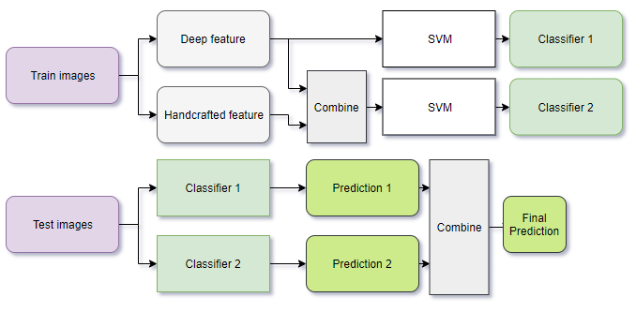
Method
Approach 3. Combine both predictions and features (Full-fusion)

Slide 12
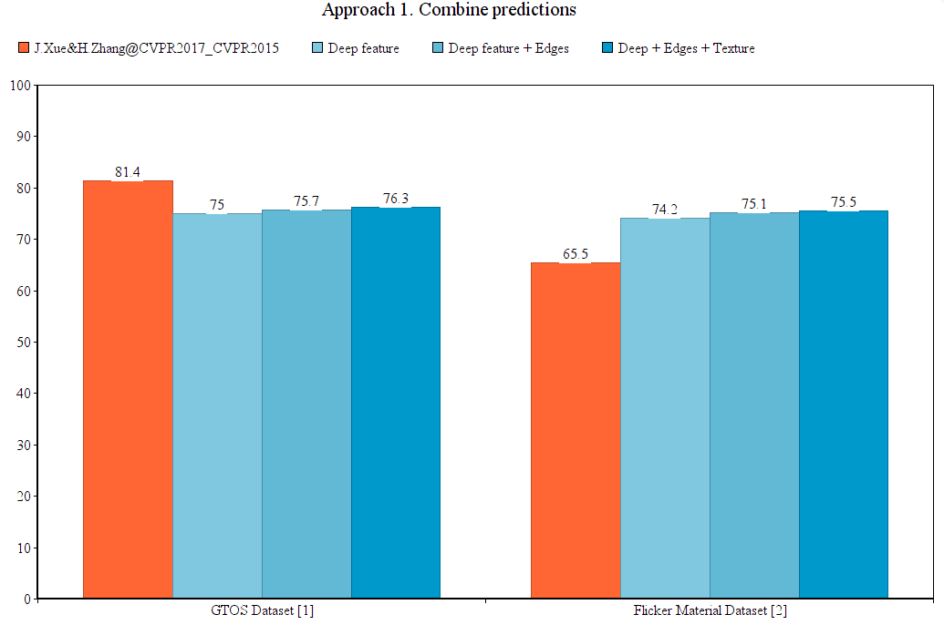
Results on GTOS & FMD dataset

Slide 13
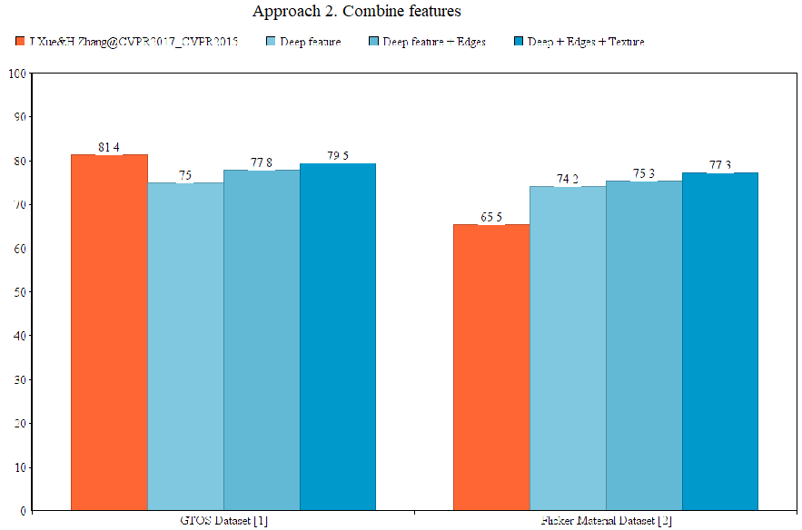
Results on GTOS & FMD dataset

Slide 14
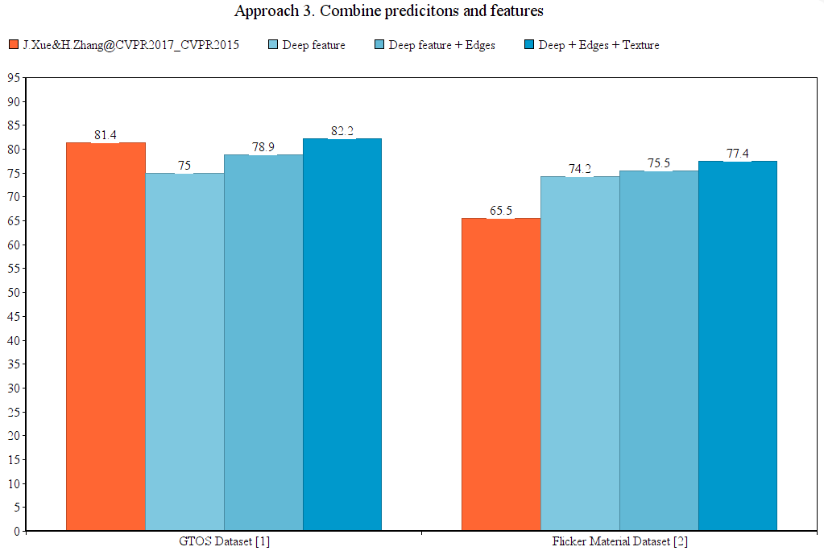
Results on GTOS & FMD dataset

Slide 15
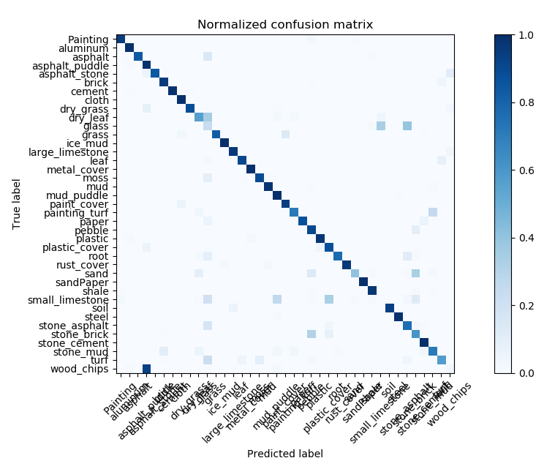
Results on GTOS & FMD dataset
Figure 1. Confusion matrix on GTOS dataset

Slide 16
Conclusion
Extendable
No limited for features we choose to combine, but need to choose the “suitable” one for each dataset.
Can be used in other classification problems.
Disadvantages
More features – more computations.
Wrong features – bad result.

Slide 17
References
[1] Corbett-Davies, Sam. "Real-World Material Recognition for Scene Understanding."
[2] NVIDIA, ADVANCED DRIVER ASSISTANCE SYSTEMS. [Online]. Available: https://www.nvidia.com/en-us/self-driving-cars/adas/
[3] M. W. Spong, S. Hutchinson, and M. Vidyasagar, Robot modeling and control. Wiley New York, 2006, vol. 3.
[4] J.-H. Kim, E. T. Matson, H. Myung, and P. Xu, Robot Intelligence Technology and Applications 2012: An Edition of the Presented Papers from the 1st International Conference on Robot Intelligence Technology and Applications. Springer Science & Business Media, 2013, vol. 208.
[5] Xue, Jia, et al. "Differential angular imaging for material recognition." arXiv preprint arXiv:1612.02372 (2016).

Slide 18

More questions about this task?
For more detail please email me at 14520040@gm.uit.edu.vn.
Look for more information about the data set
Interested in my work, you can find it here
Give feedback about this work
Notes:
In Slide Show mode, select the arrows to visit links.

Slide 19
Thank you for watching
Computer Vision

